Slide 1
INTRODUCTION TO THE RESEARCH PROCESS
Mirela Gutica
Comp 7036
Winter 2010

Slide 2
Research Proposal
Answers the questions:
  What is the research question?
  What is the motivation of the research?
  What was said/discovered/studied/implemented in this respect so far?
  What methodologies and methods should be employed?
  How do you justify the choice of methodologies and methods?
The justification of choice and a particular use of a methodology and methods is related to the theoretical perspective of the author and the context of that research

Slide 3
Methodologies
Choosing a research method can be intimidating considering that there are a large variety of methodologies and methods.
How can you be sure which methodology is appropriate, or whether your chosen combination of methods is consistent with the theoretical perspective you want to take?

Slide 4
Elements of the Research
What methods do we propose to use?
What methodology governs our choice and use of methods?
What theoretical perspective lies behind the methodology in question?
What epistemology informs this theoretical perspective?
  (Crotty, 1998, p. 2)

Slide 5
Epistemologies and Theoretical Perspectives
Epistemology: The theory of knowledge that represents the grounds of the theoretical perspective
Theoretical Perspective: The philosophical/theoretical position of the author of the study: approach to explaining the context of the research

Slide 6
Methodologies and Methods
Methodology: The strategy, plan of action, process or design employed for a particular study in order to obtain the desired outcome
Methods: The techniques or procedures used to gather and analyze data

Slide 7
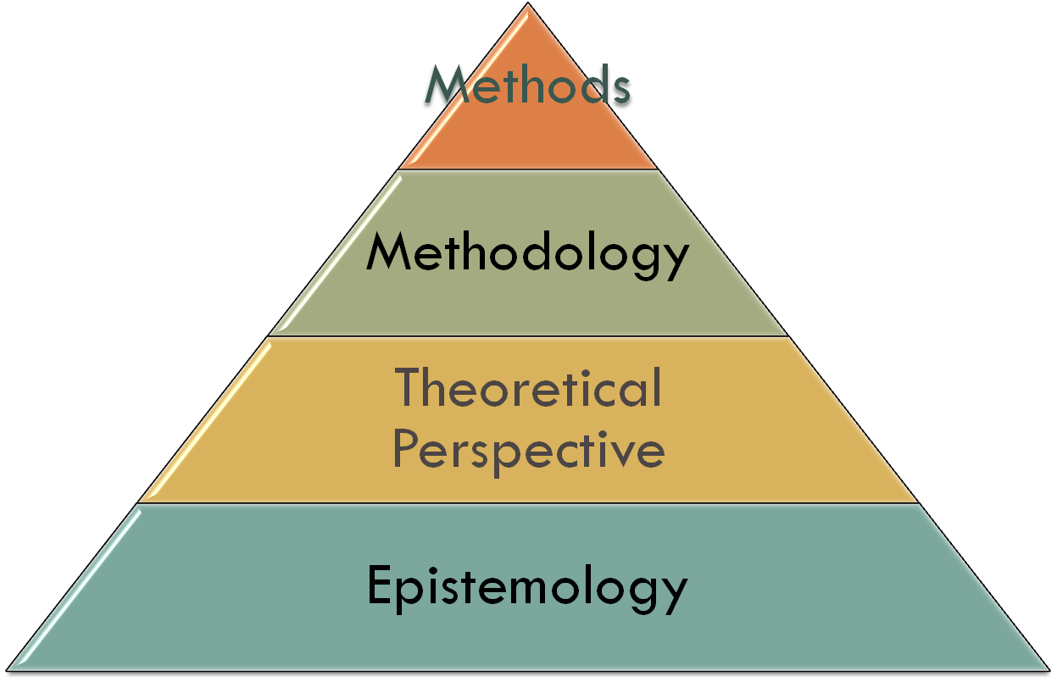
The Foundations of Social Research
  (Crotty, 1998, p. 4)

Slide 8
Epistemology: How we Know?
The epistemological dimension concerns the ways in which we can obtain knowledge about the world
  Objectivism
    Things exist independently of our consciousness and experience
  Constructionism
    Meaning is constructed: Things exist because we constructed them in relationship with our world. However, we build our knowledge on objects. Generally refers to social constructs
  Subjectivism
    The meaning is imposed by the subject to the object

Slide 9
Theoretical Perspectives
Positivism
  Science is considered as the way to get at truth, to understand the world, predict phenomena and control the world
Post-positivism
  recognizes that the science cannot always predict and control the world
Interpretivism
  Social settings or cultures can be understood by studying what people think, their ideas, and the meanings that are important to them

Slide 10
Theoretical Perspectives (2)
Structuralism
  Emerged from the difficulties of positivism in dealing with human sciences. Structuralism is based on the idea that scientific methods can me used in social studies/planning social activities, analyzing cultures, etc.
Critical Theory
Postmodernism
Post-Structuralism
Marxism
Feminism
Etc.

Slide 11
Methodologies
Experimental research
Survey research
Ethnography
Phenomenological research
  Study of experience from the perspective of the individual
Grounded theory
Action research
Discourse analysis
Descriptive research
Feminist standpoint research
Etc.

Slide 12
Methods
Sampling
Measurement and scaling
Questionnaire
Observation
  Participant
  Non-participant
Interviews
Focus group
Delphi
Case study
Life history
Narrative
Visual ethnographic method
Statistical analysis
Theme indication
Comparative analysis
Document analysis
Cognitive mapping
Data reduction

Slide 13
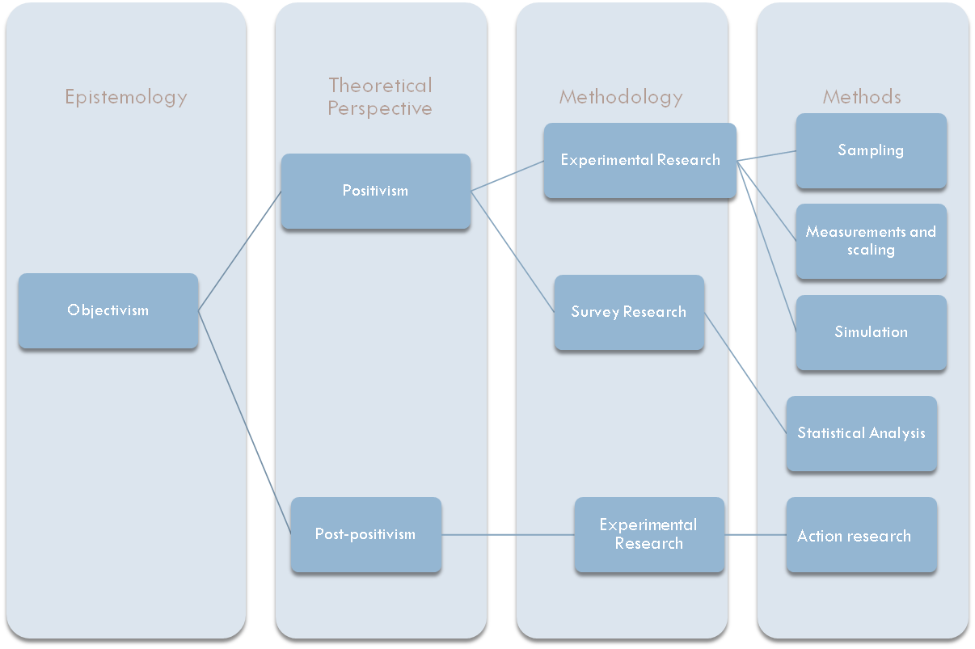
Objectivism

Slide 14
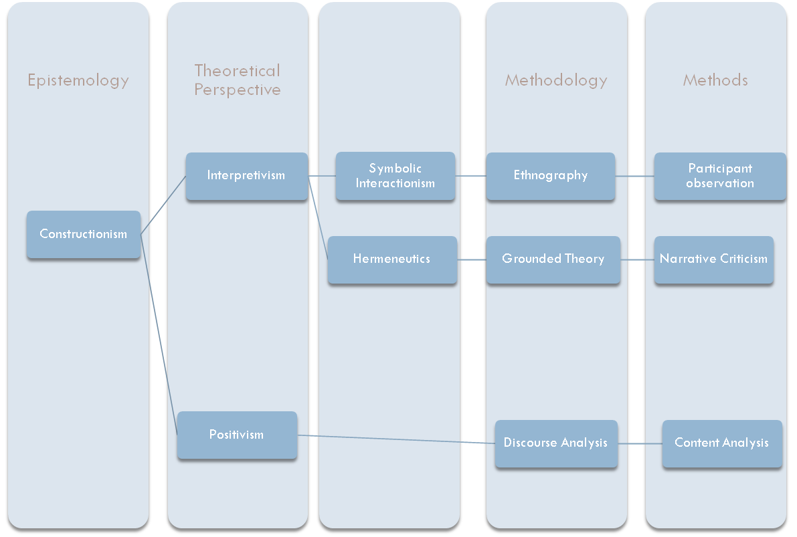
Constructionism

Slide 15
My Study:
Epistemology: ? Theory? Methodology: ? Methods?
QUAN
Data and Results
Qual
Data and Results
QUAL
Data and Results
Follow-up
Interpretation

